Slide 1
Capstone Engagement
Assessment, Analysis & Hardening of a Vulnerable System

Slide 2
Table of Contents
This document contains the following resources:
Network Topology
Red Team: Security Assessment
Blue Team: Log Analysis & Attack Characterization
Hardening: Proposed Alarms & Mitigation Strategies

Slide 3
Network Topology

Slide 4
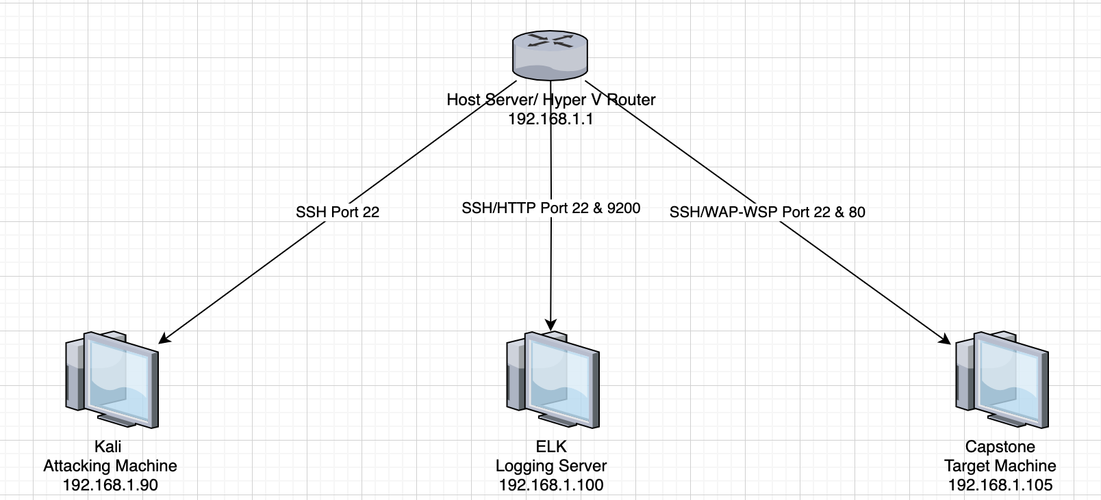
Network Topology
NETWORK
Address Range: 192.168.1.0/24
Netmask:
Gateway:
MACHINES
IPv4: 192.168.1.1
OS: Microsoft
Hostname: ML-RefVM-684427
IPv4: 192.168.1.90
OS:
Hostname: Kali
IPv4: 192.168.1.100
OS: Intel Corporate
Hostname: ELK
IPv4: 192.168.1.105
OS: Microsoft
Hostname: Server1

Slide 5
Red Team
Infiltrating the Target

Slide 6
Recon: Describing the Target
NMap Scan Results
Nmap identified the following hosts on the network.
Hostname | IP Address | Role on Network
ML-RefVM-684427 | 192.168.1.1 | Host, Hyper V Manager, Gateway
Kali | 192.168.1.90 | Pentesting Machine
ELK | 192.168.1.100 | Monitoring Machine (Elasticsearch, Logstach, Kibana)
Server 1 (Capstone) | 192.168.1.105 | Target Machine (Apache, Network Shares)

Slide 7
Vulnerability Assessment
Our assessment uncovered the following critical vulnerablities in the target.
Vulnerability | Description | Impact
Ability to Bruteforce Webform | The password hash for Ashton can be easily bruteforced | Ashton’s account is not secure and information in company_folders/secret_folder is vulnerable
Insecure Website | Due to poor admin work, the website shares the path for hidden directories as well as password hashes | Information is not hidden and can be exploited against the target
Write to Webdav Directory | We are able to add any files to the webdav directory | Allows us to upload a reverse shell

Slide 8
Exploitation: Ability to Bruteforce Webform
Using Hydra, we are able to create a command to easily bruteforce Ashton’s password
This allows us to access company_folders/secret_folder and gain access to critical information

Slide 9
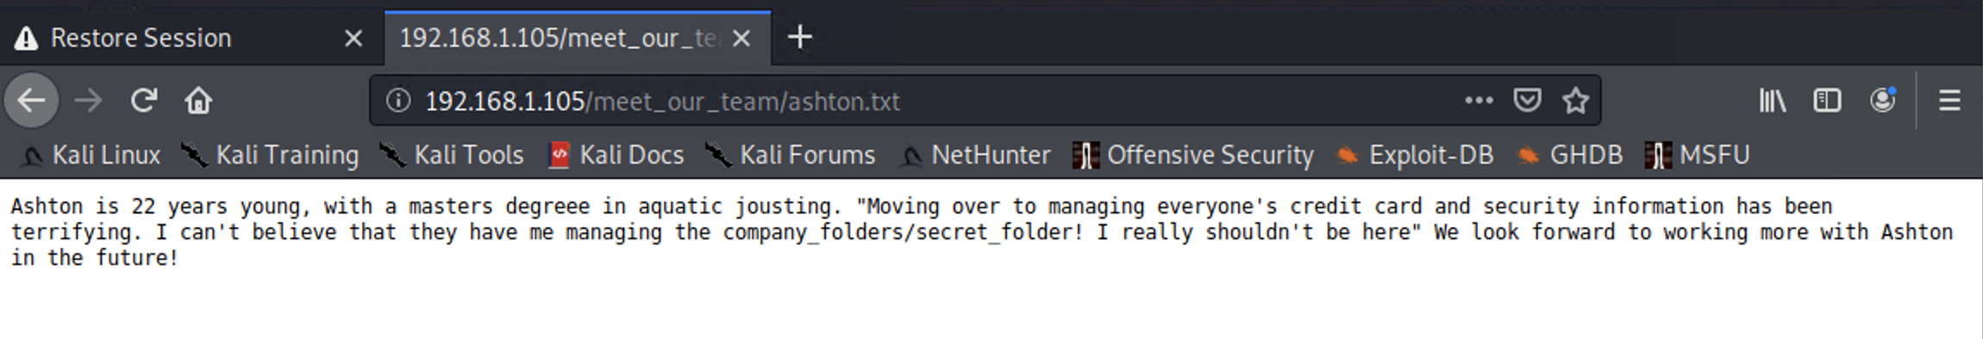
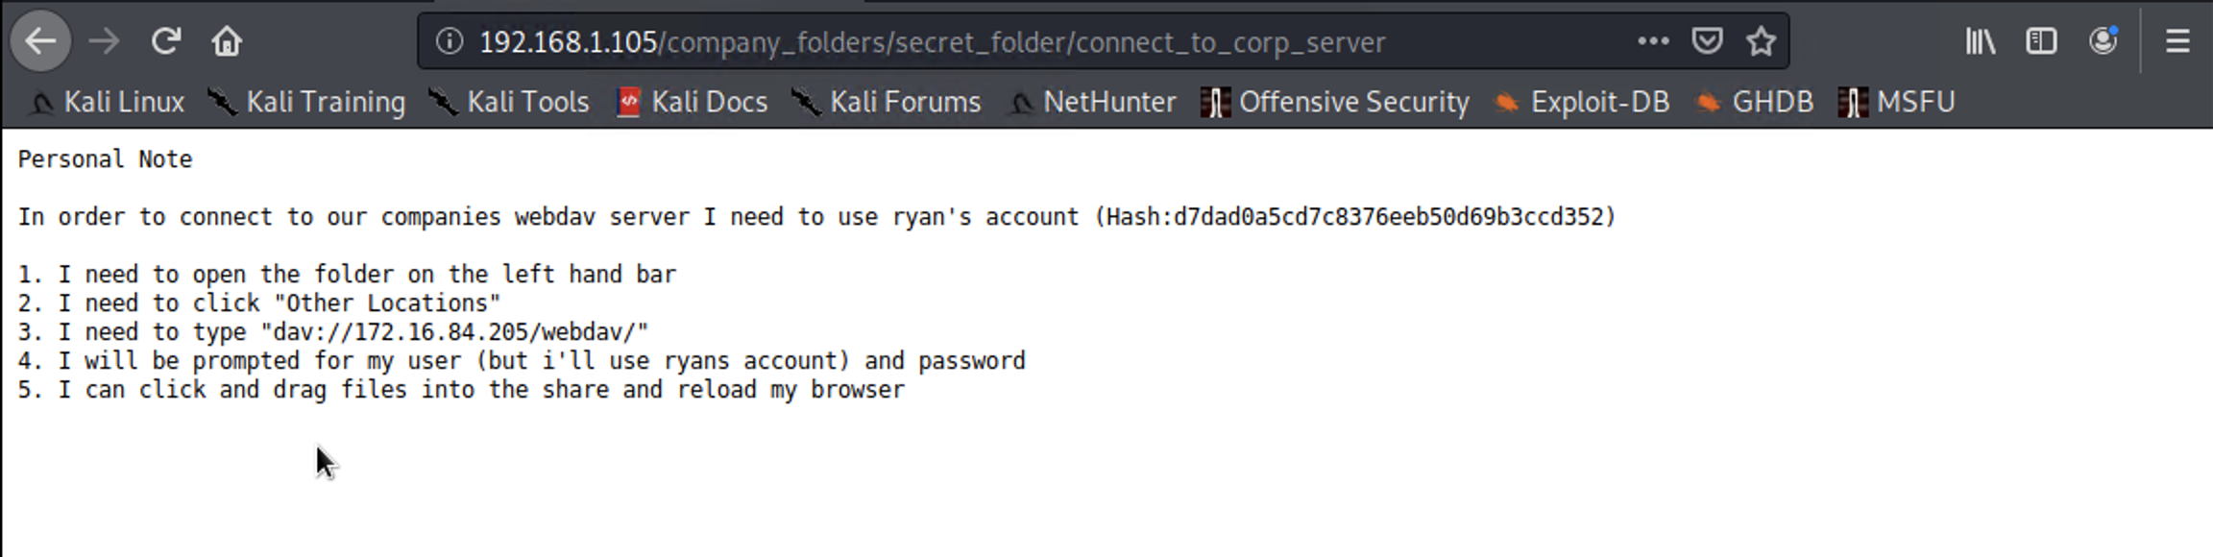
Exploitation: Insecure Website
Using social engineering, we are able to exploit critical information that helps us find vulnerabilities in the security of 192.168.1.105

Slide 10
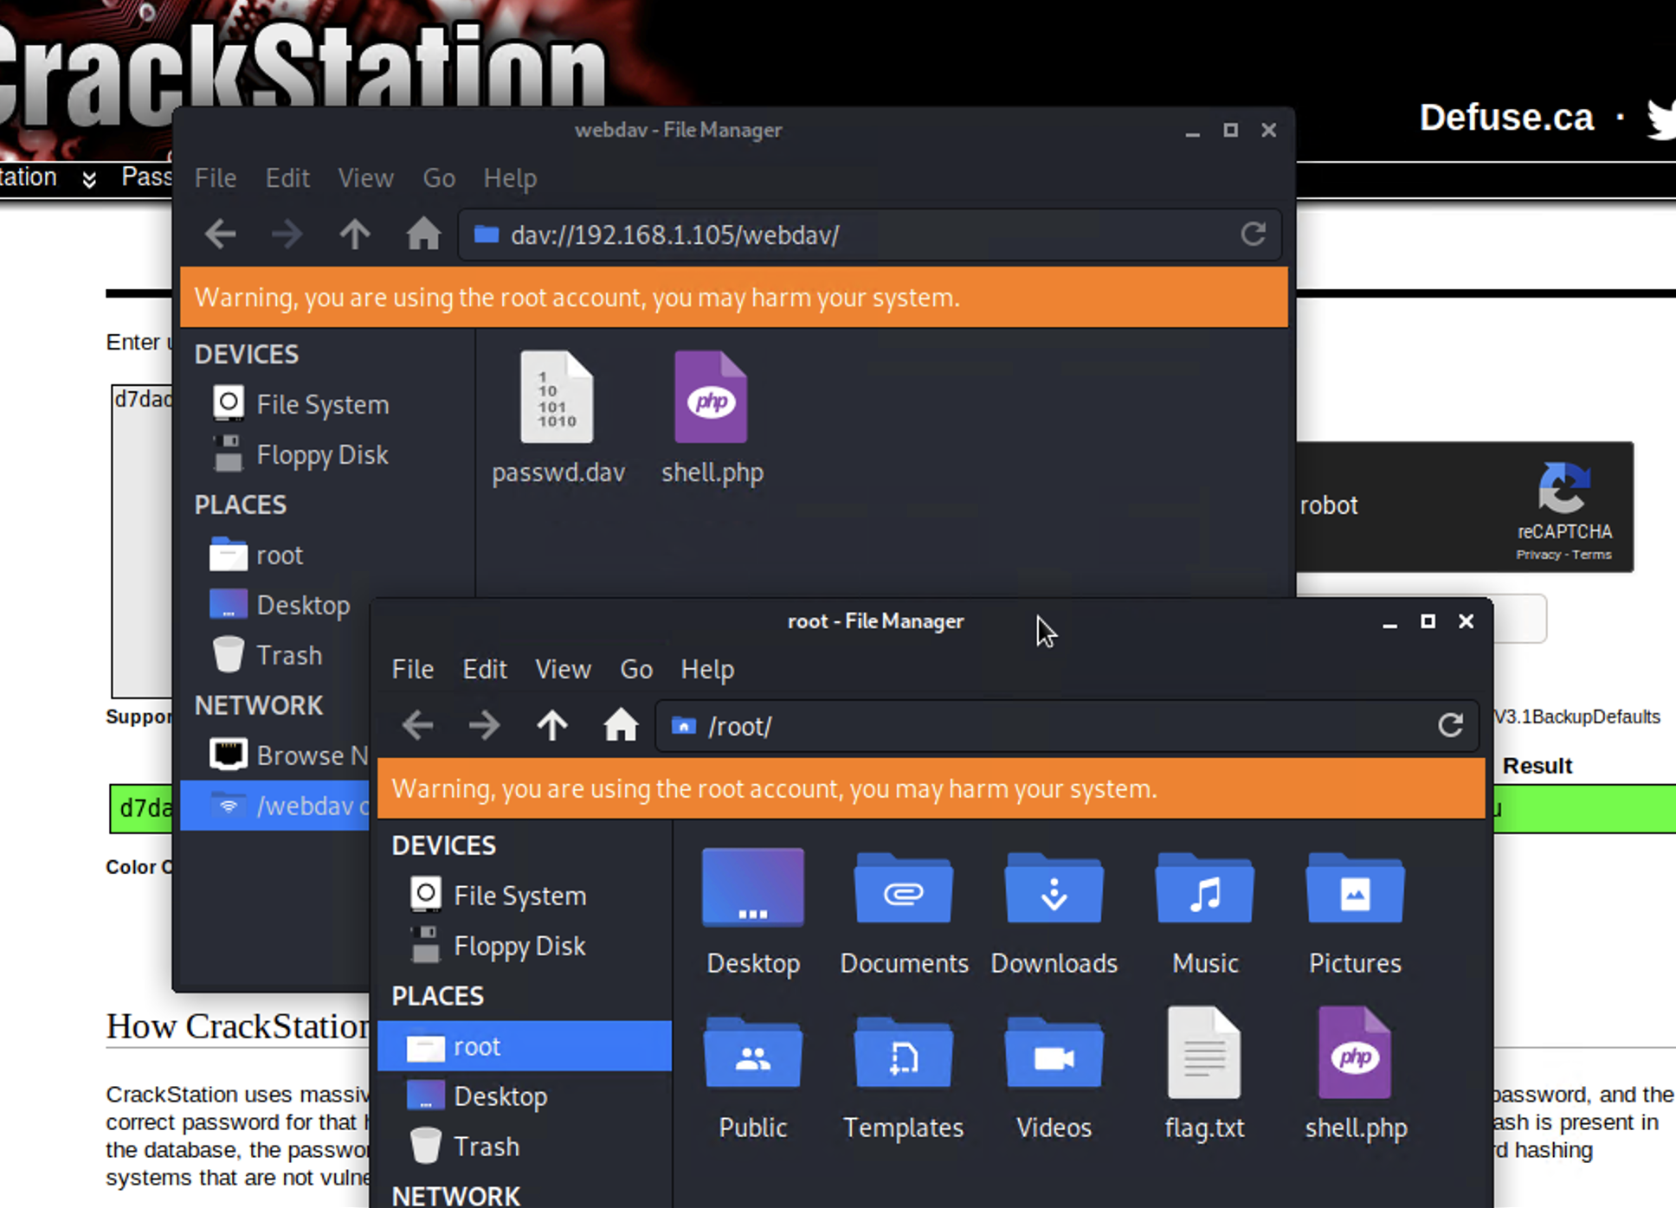
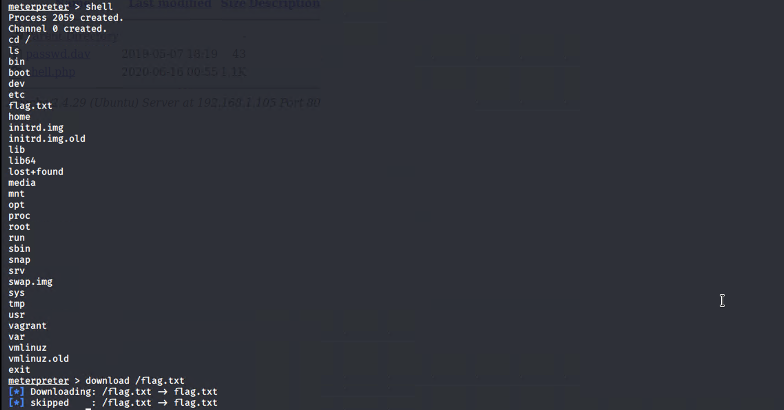
Exploitation: Write to Webdav Directory
By gaining access to the webdav directory we are able to upload a PHP reverse shell payload
This allows us to gain access to the target server and find the objective in flag.txt

Slide 11
Blue Team
Analysing the Incident

Slide 12
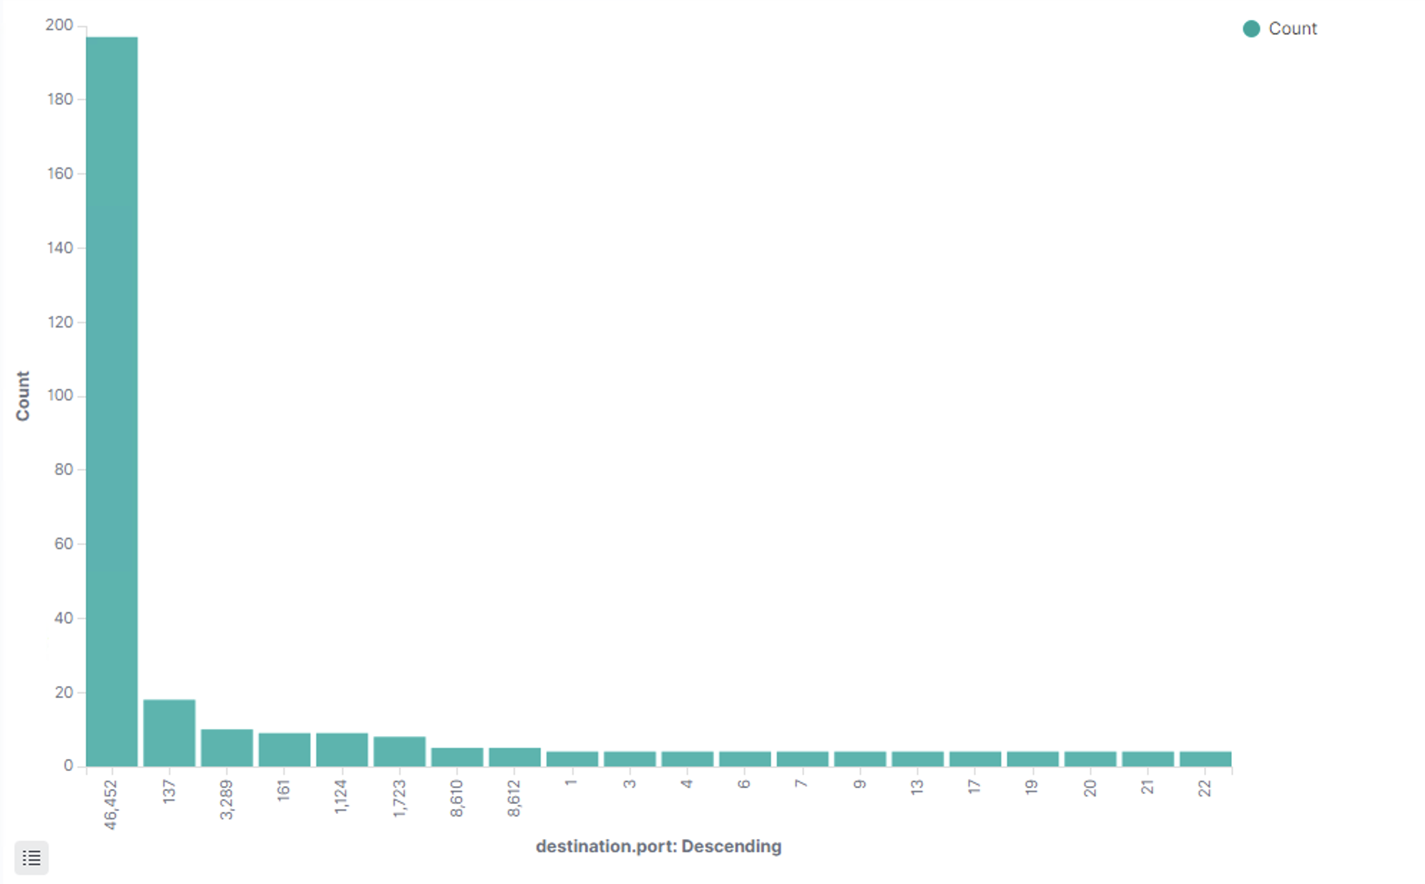
Analysis: Identifying the Port Scan
Time: 19:18:30 on 2020-06-15
Number of Packets: 4245 packets were sent from 192.168.1.90
Indicative of a port scan due
to the large number of ports
sent packets

Slide 13
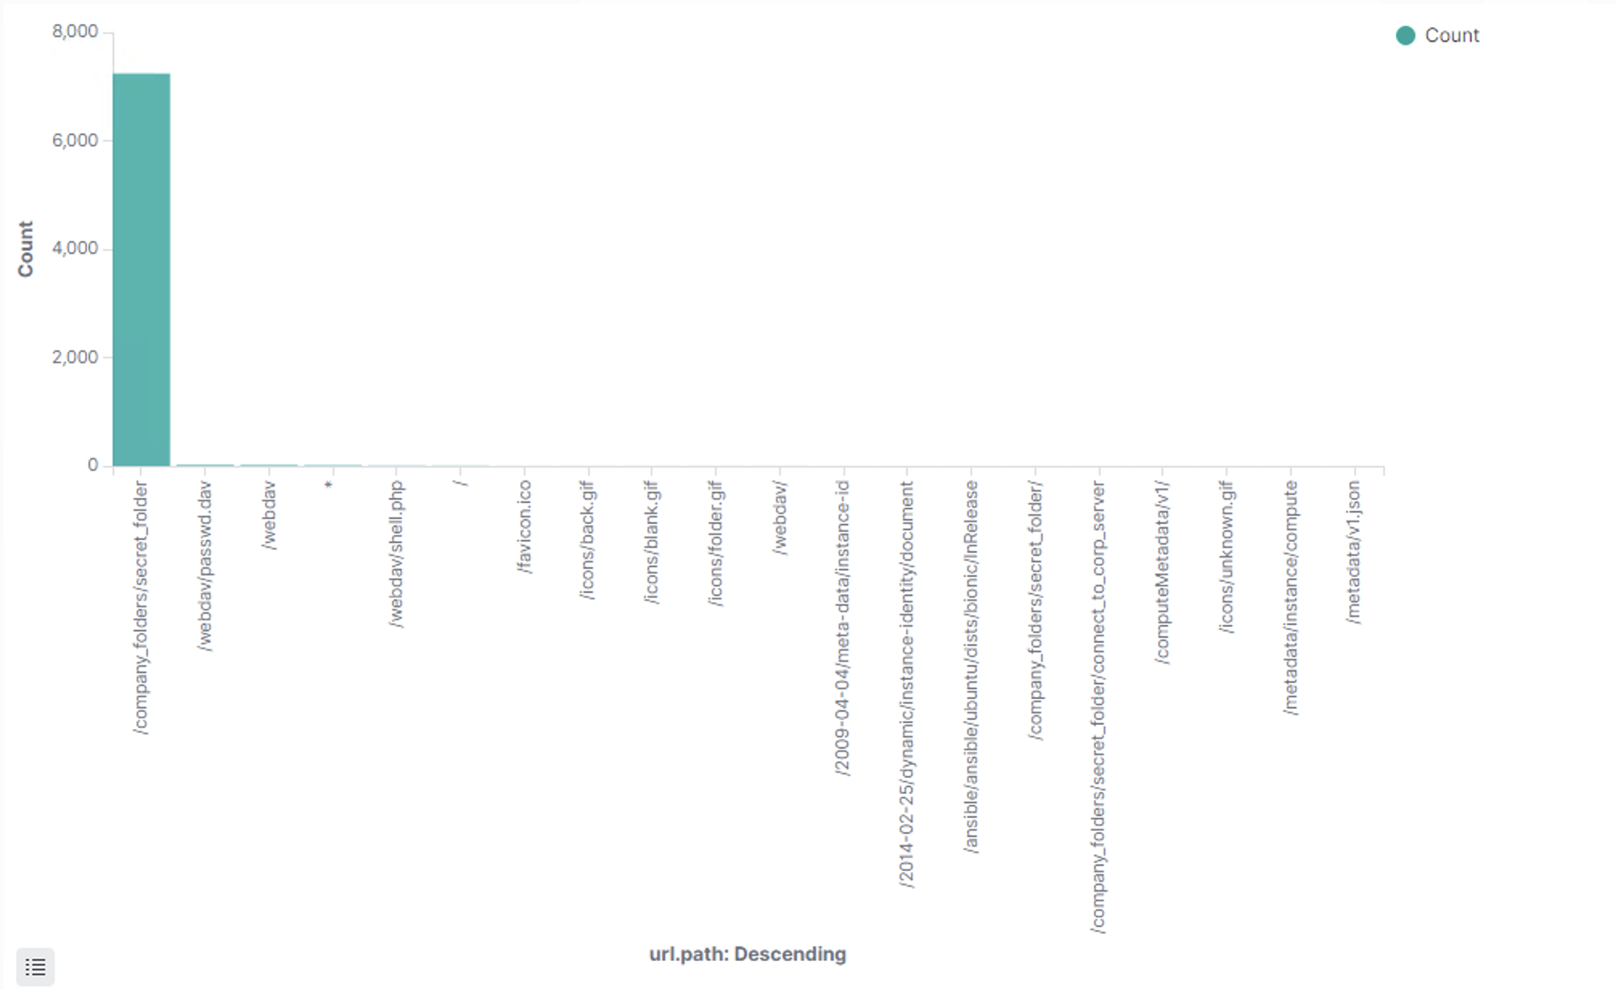
Analysis: Find the Request for the Hidden Directory
Time: 20:00:00
Number of Requests: 7239
Files Requested:
company_folders/secret/folder
Contains instructions for
accessing webdav

Slide 14
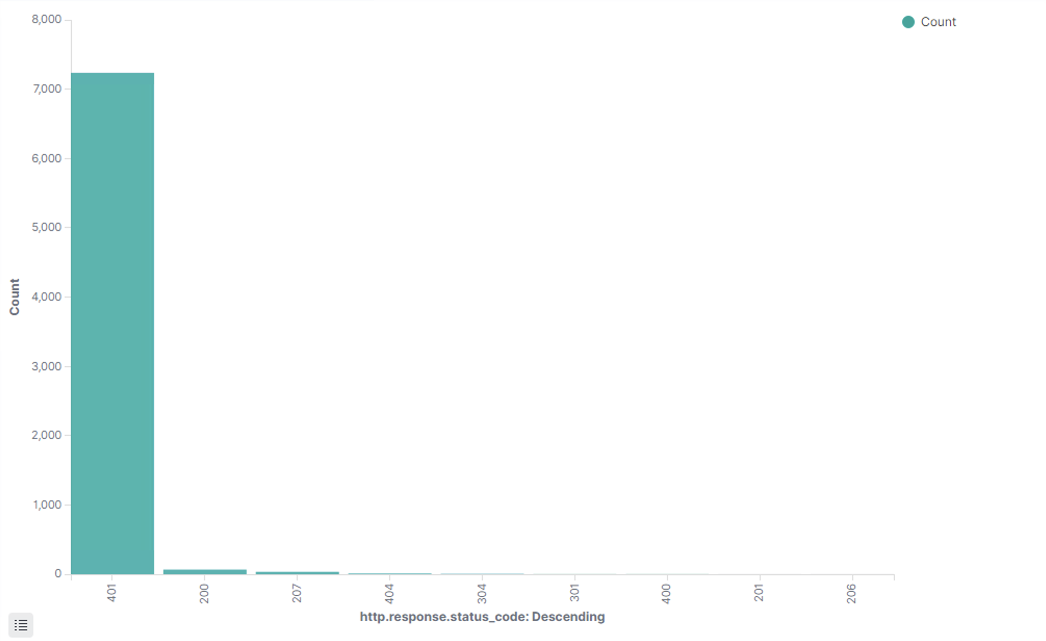
Analysis: Identifying the Brute Force Attack
Number of requests: 7237
Password Discovery: 7236 Attempts

Slide 15
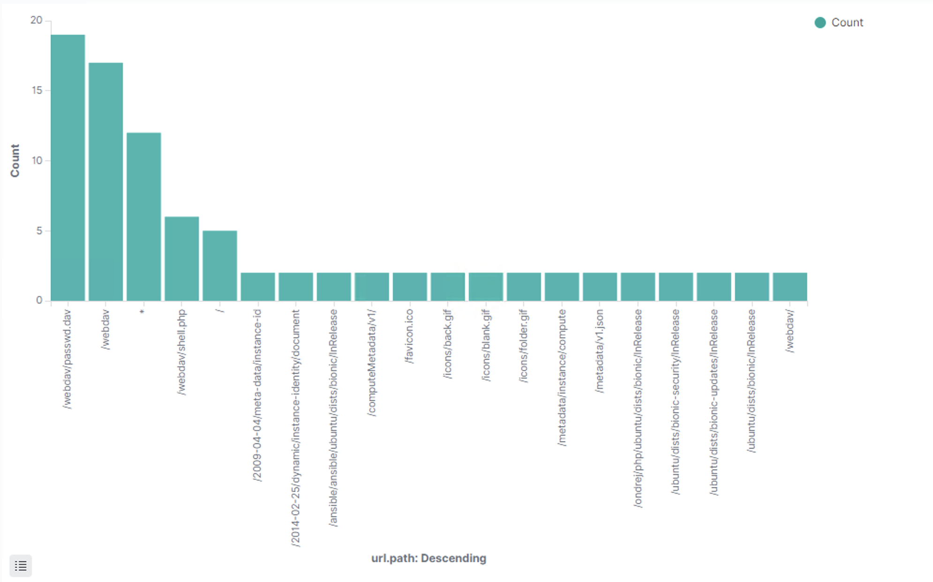
Analysis: Find the WebDAV Connection
Total number of requests: 44
Main file requested:
webdav/passwd.dav
Number of requests
for webdav/passwd.dav: 17

Slide 16
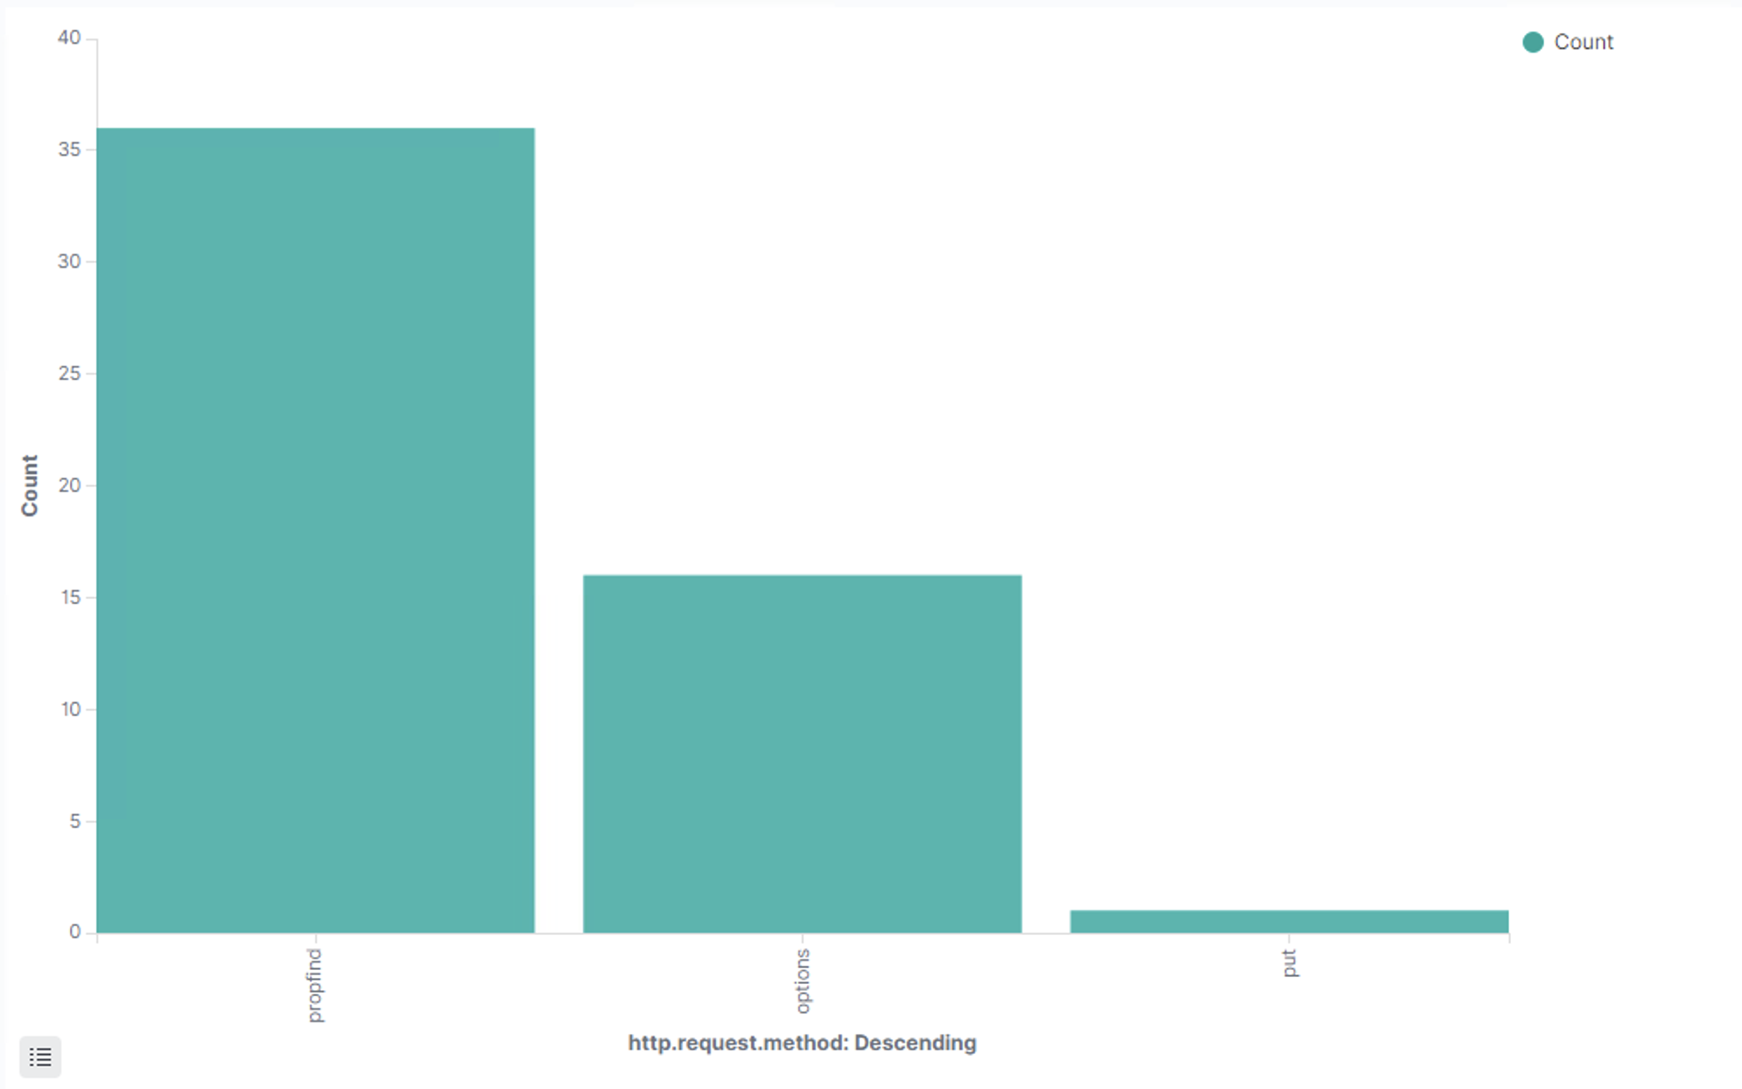
Analysis: Identify the Reverse Shell Upload
Protocol Used: HTTP Put
In the log query,
under the Put request
it states webdav/shell.php
indicating a reverse shell upload to
the site

Slide 17
Mitigation
Hardening the System

Slide 18
Blocking the Port Scan
ALARM
Any attempt to scan ports via nmap with a threshold of one
SYSTEM HARDENING
Move vulnerable port services outside of the default nmap 1000 port scan

Slide 19
Analysis: Find the Request for the Hidden Directory
ALARM
HTTP status code of 200 for that directory from any unauthorized IP with a threshold of one
SYSTEM HARDENING
Disable the ability to modify the URL
Validate the IP against a list of whitelisted IPs (Blocking external IP access)

Slide 20
Analysis: Identifying the Brute Force Attack
ALARM
Multiple HTTP GET requests over a short period of time with a threshold of 10
Monitoring the number of failed log-ons (400-type codes) from a specific IP to a specific target with a threshold of 5
SYSTEM HARDENING
Block 192.168.1.90 IP and introduce delays between password attempts

Slide 21
Analysis: Find the WebDAV Connection
ALARM
Multiple requests to webdav, threshold of 5
SYSTEM HARDENING
Only authorize certain users with the ability to access and write to webdav

Slide 22
Analysis: Identify the Reverse Shell Upload
ALARM
HTTP Put request with a threshold of one
SYSTEM HARDENING
Disable HTTP Put requests from the internet
Restrict access to webdav
Hide the password hash on the website

Slide 23
The End

